Slide 1
Handling Exceptions

Slide 2

How to customize Spring Security exception handling for:
Overview
Login failures.
Authorization errors.
Replace spring white label exceptions pages with your own.
Perform tasks post authentication and authorization failure.

Slide 3
Understanding Spring Security Exception
Handling

Slide 4
Don't Forget About Application Exceptions

Slide 5
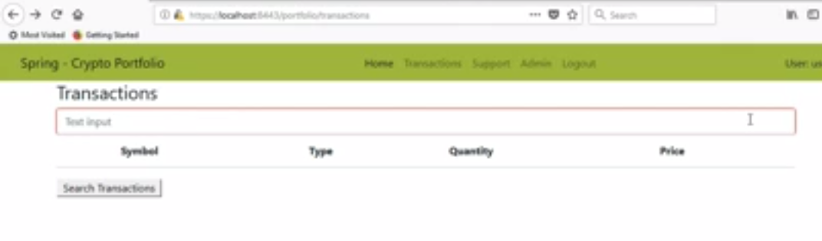
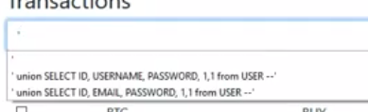

Slide 6
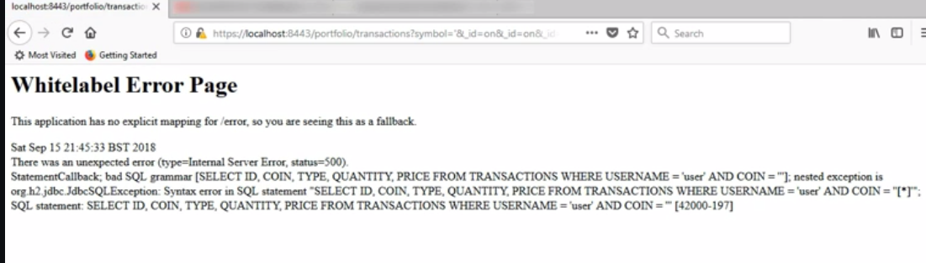

Slide 7
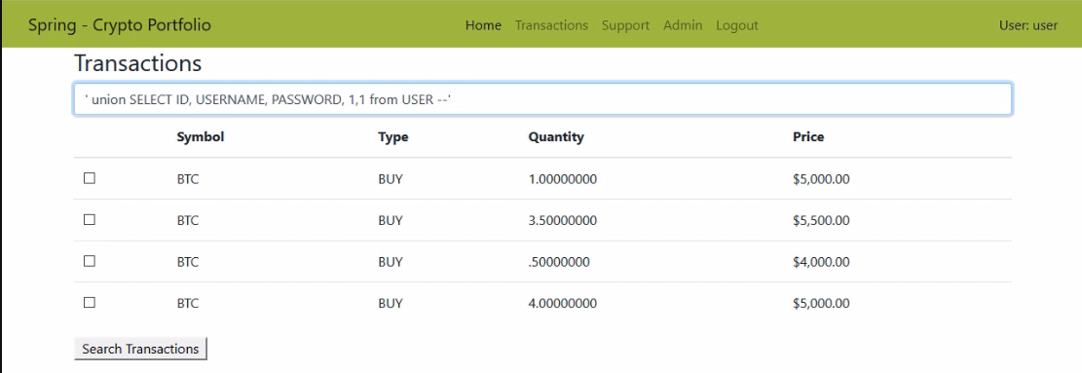

Slide 8
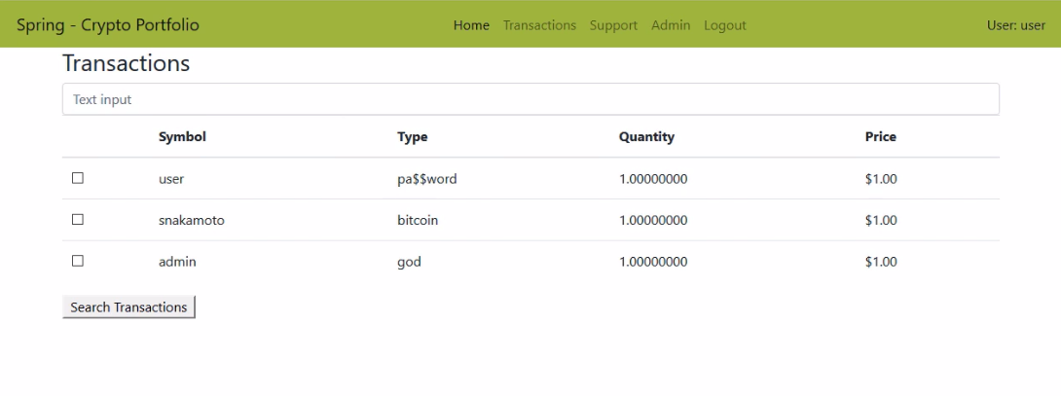

Slide 9
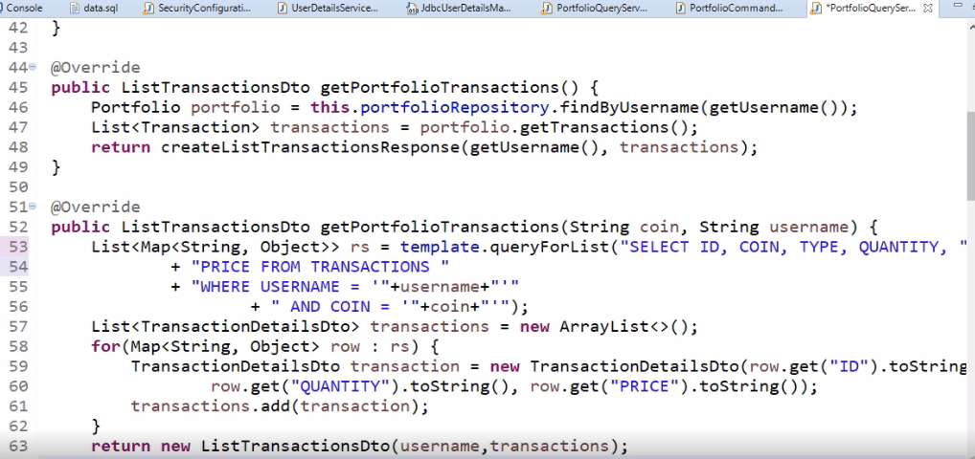

Slide 10

Module and course complete!

Slide 11


Secure Coding
Limited recognition
Piece of mind

Slide 12

What next?
Check out advanced topics on:
Securely storing credentials.
Multifactor authentication.
Session management.
Advanced authorization techniques.
Oauth2 and OIDC.

